Slide 1
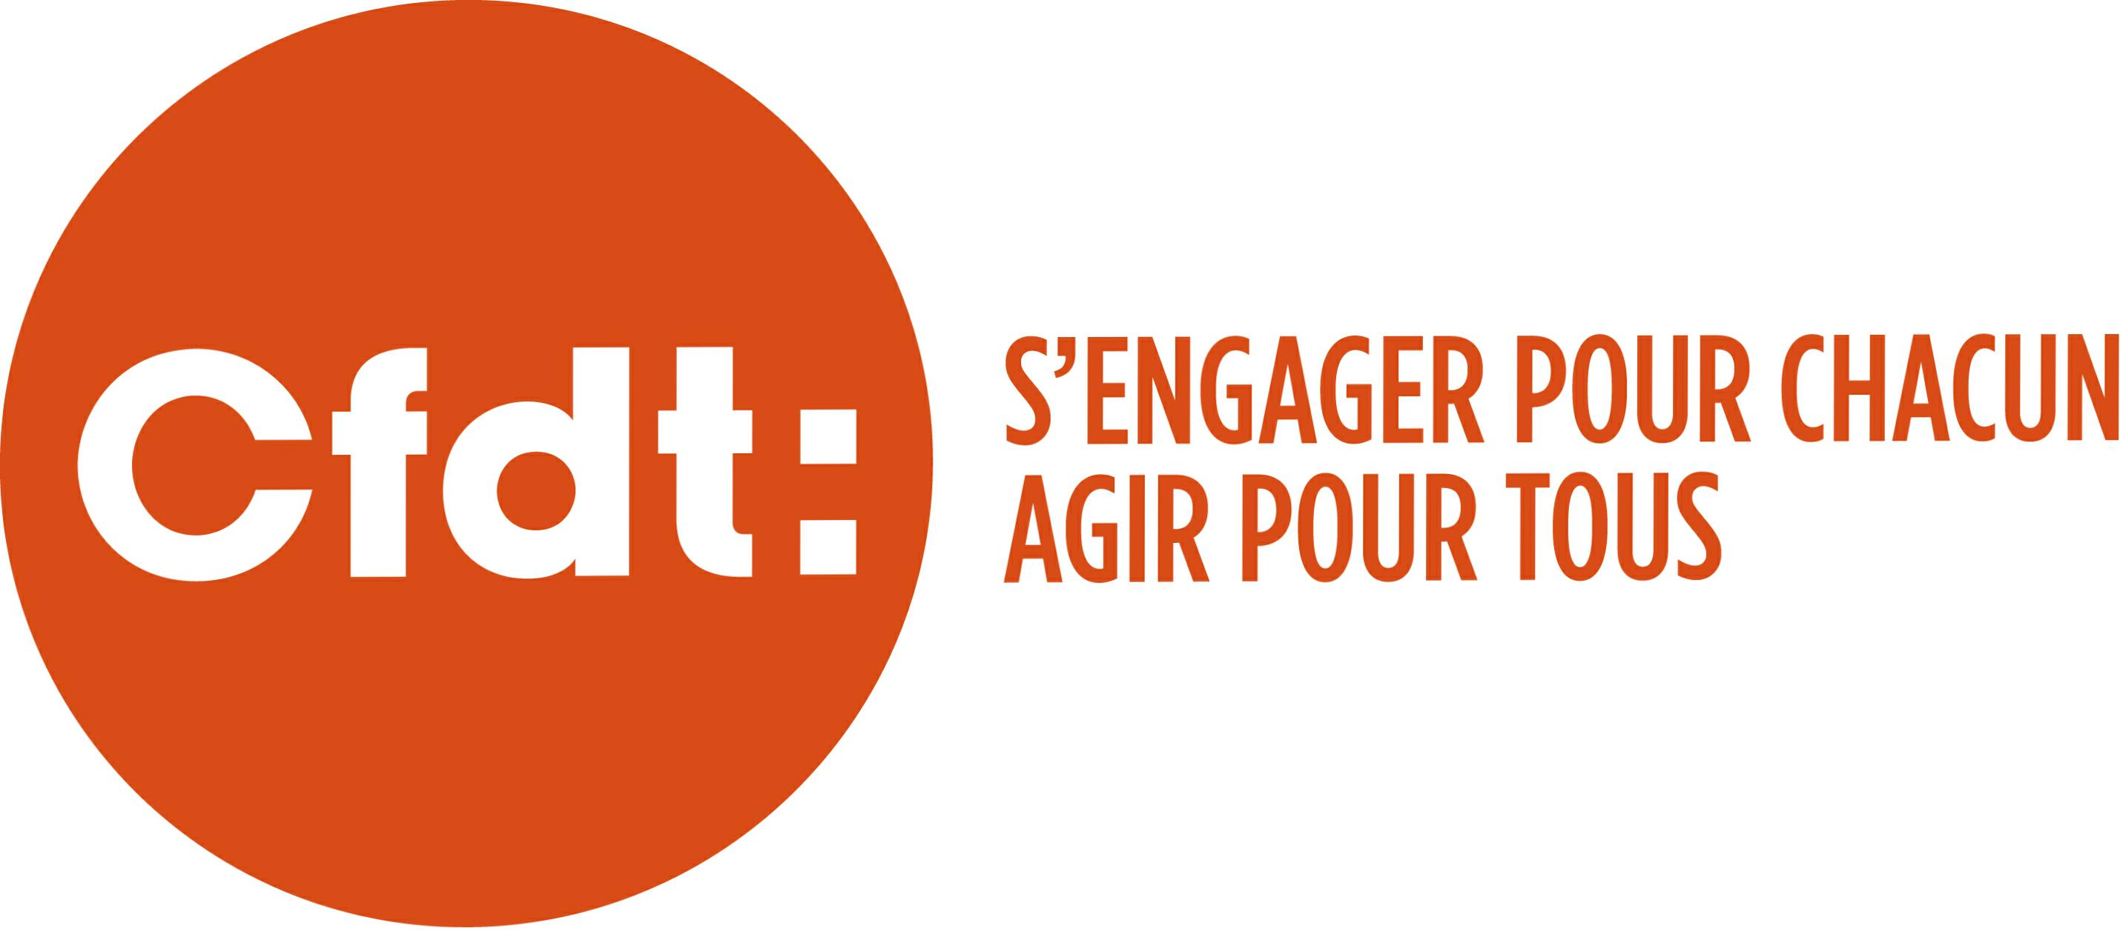
UNION by f3c cfdt
A new approach to syndicalism !
After disruption, time for syndisruption.

Slide 2
for several years the rate of trade syndicalism in france has fallen…you can observe the evolution since 1975,year of my birth !

Slide 3
our digital environment needs to be transformed. the survival of our organizations is at stake… … as well as its dna.

Slide 4
Our response : union
is a collaborative space, always in motion, for all digital workers.
is a space of « ideation » where the focus group mode is the impetus.
is to act as the principle of the project mode.
it is to be proactive, collaborative.
is to build projects and services together, is to be a digital player.

Slide 5
It’s time to build a new world of syndicalism with union by f3c CFDT, the platform that frees the independents !

